Slide 1
Part 1
USE CASE：Millimeter-wave CW Radar Testbed Developed in GNU Radio
A mmwave CW radar based on SDR was developed using GNU Radio to evaluate the performance of the Doppler frequency shift, which is used for estimating the velocity of the DUT. The frequency shift is filtered and displayed at TP7. Furthermore, the Doppler frequency shift can be audibly played through the sound card at TP8.

Slide 2
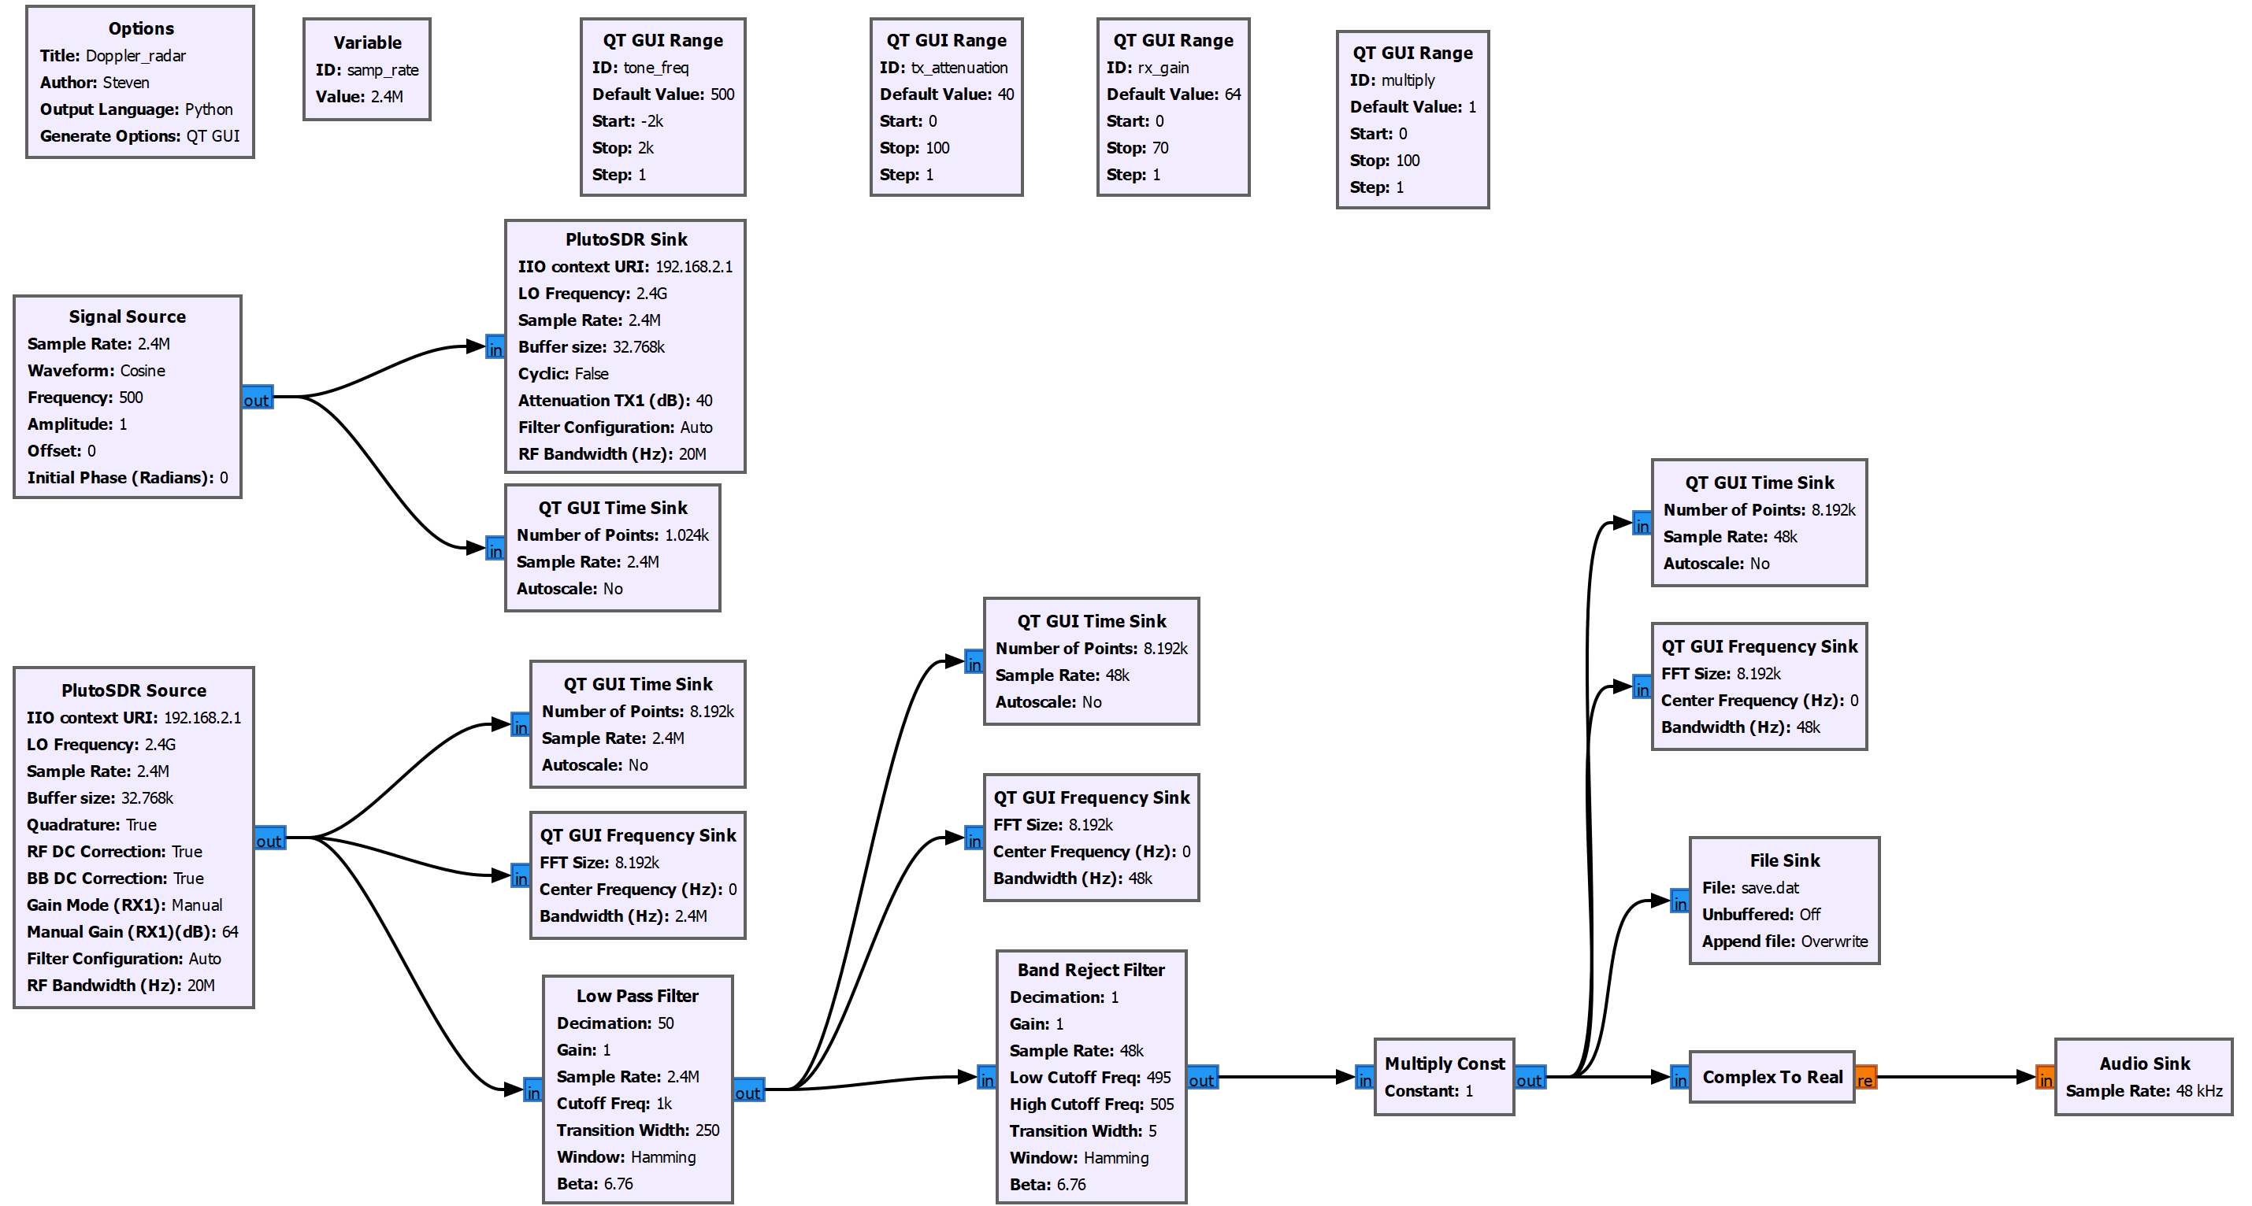
GNU Radio - Millimeter-wave CW Radar Function Diagram
*TP6
*TP1
*TP4
*TP7
*TP2
*TP5
*TP3
*TP8

Slide 3
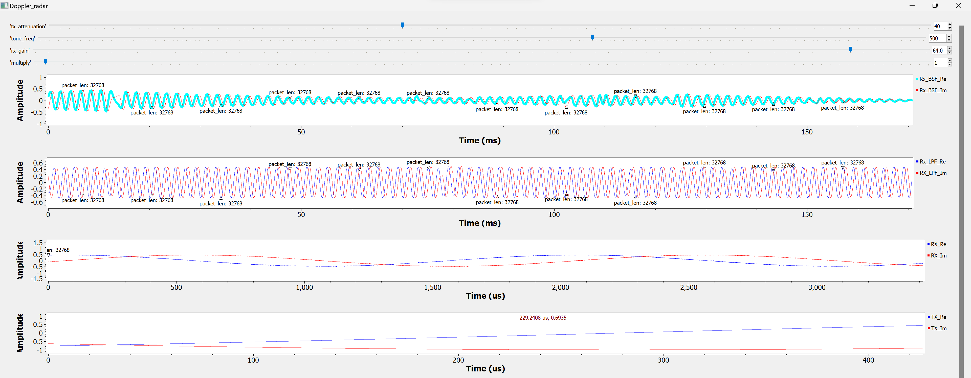
Millimeter-wave CW Radar – Testing Result
*TP6
*TP4
*TP2
*TP1

Slide 4
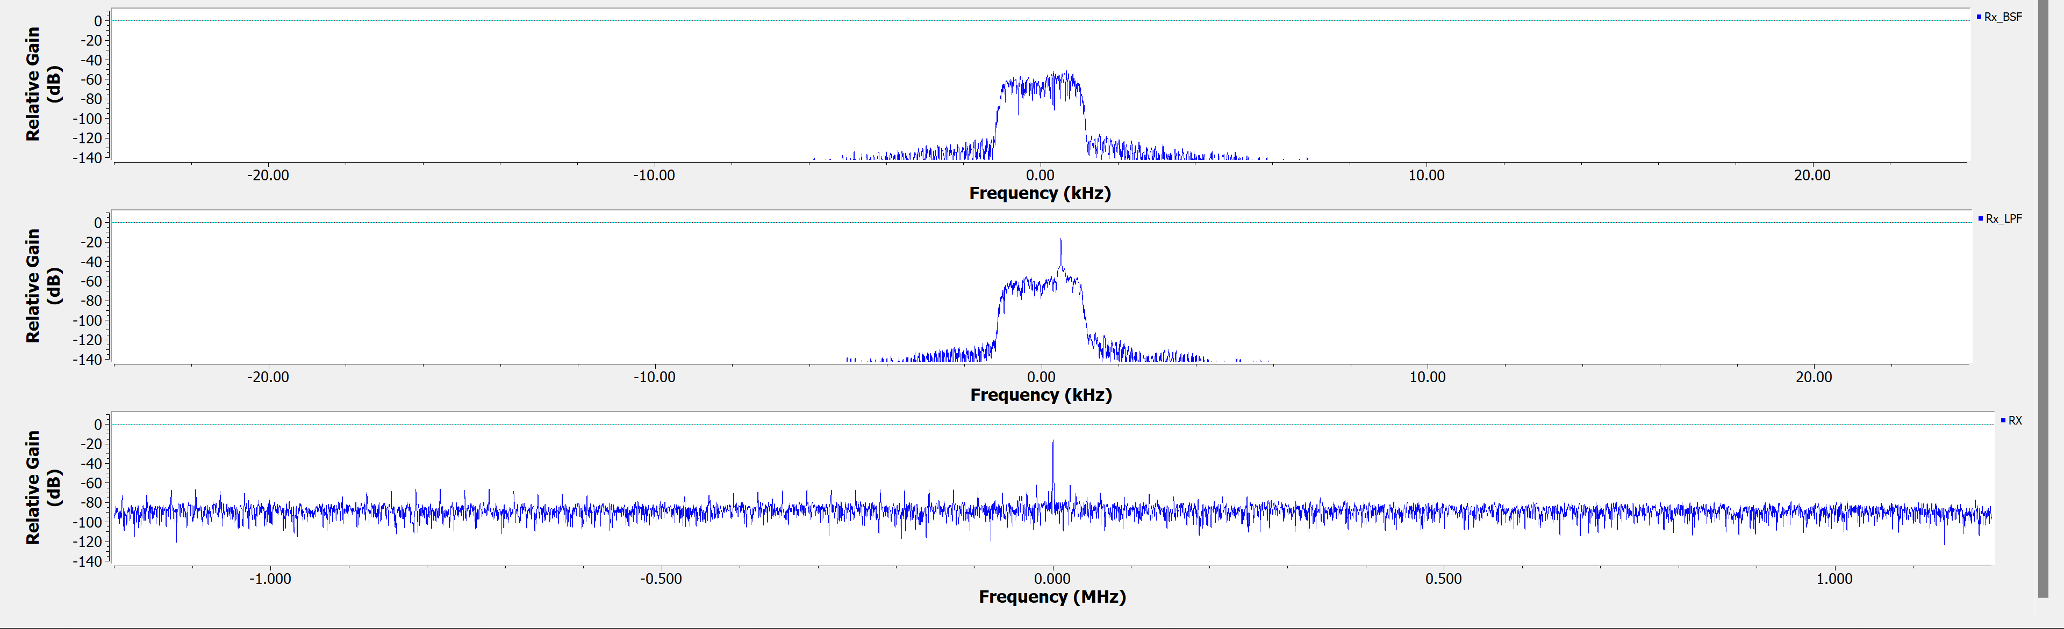
Millimeter-wave CW Radar – Testing Result
*TP7
*TP5
*TP3

Slide 5
Part 2
USE CASE：Millimeter-wave Pulsed Doppler Radar
A mmwave pulsed Doppler radar, built on an SDR platform, was created using GNU Radio to monitor the reflected echo signals from obstacles. You can modify the pulse repetition interval (PRI) by adjusting the parameters of the vector source. The reflected echo from the obstacles can be observed at TP4.

Slide 6
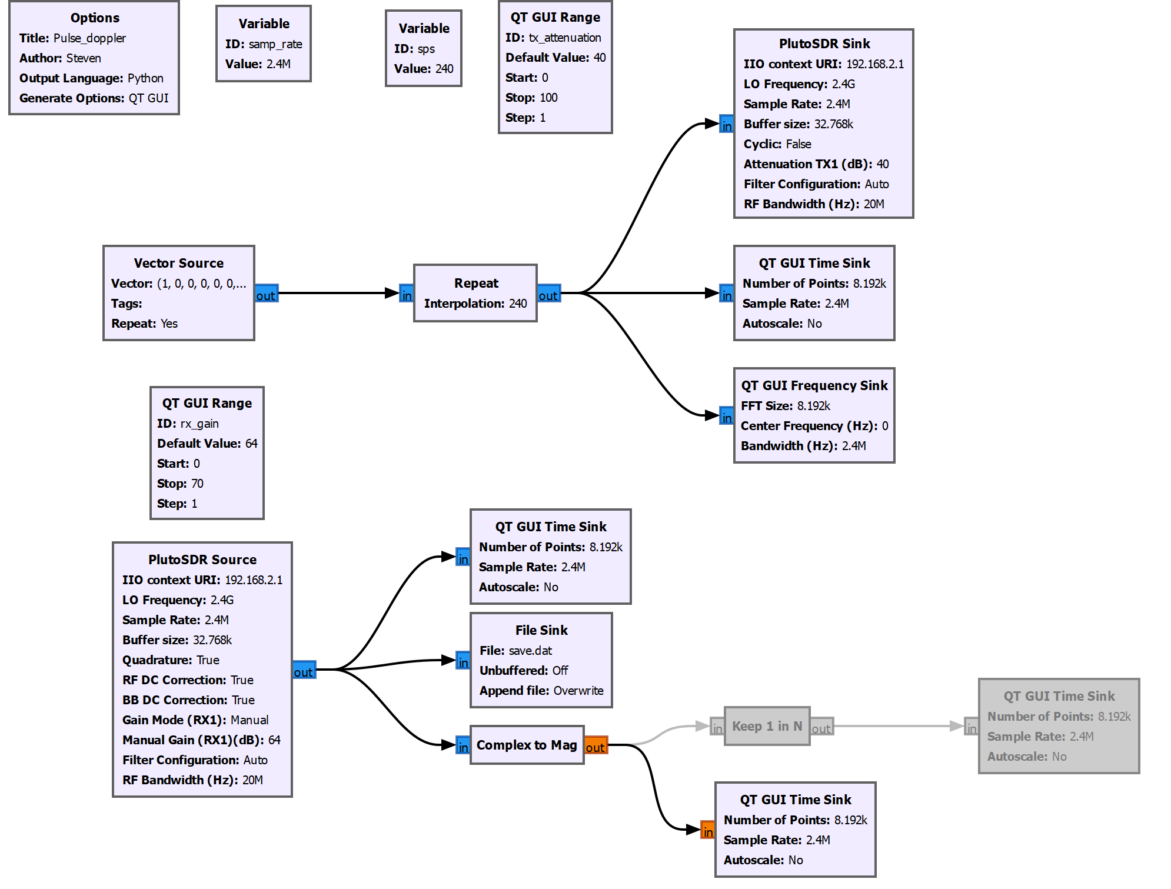
GNU Radio - Millimeter-wave Pulsed Doppler Radar Function Diagram
*TP1
*TP2
*TP3
*TP4

Slide 7
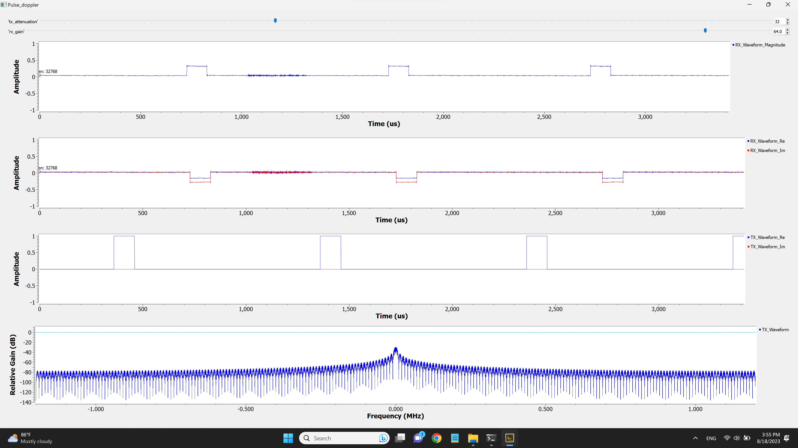
Millimeter-wave Pulsed Doppler Radar – Testing Result
Obstacle reflection
*TP4
*TP3
*TP1
*TP2

